Slide 1
Vacat Stores Analysis Report
By Mariam Ariya
22nd August 2022

Slide 2
Background
Vacat Stores is an ecommerce retail industry that helps to solve the needs of the people of the United States.
With the help of the science and analytics team seek to develop an analytics dashboard that would track and monitor KPI metrics towards the business goals and help them derive real-time insights for informed decision making to help drive growth.

Slide 3
Goal
Perform ETL process, build a data model and apply statistical methods to the dataset.
Analyze the dataset and transform it into an analytics dashboard to help Vacat Stores track and monitor the KPI metrics towards their business goals and derive real-time insights to inform decision making to aid growth.
Significantly reduce reporting time by automating the report process.

Slide 4
Methodology
Datasets was aggregated from disparate sources (PostgreSQL, Salesforce and ERP system) into a centralized platform which solves the data silo problems.
SQL queries was used to extract datasets from the relational database management system (PostgreSQL).
Dataset was extracted, transformed by ensuring correct data type for each column, loaded and built a data model by connecting the common column in each table using PowerBI.
Performed descriptive analysis to help understand the summary of the datasets by applying statistical calculations using DAX functions.
Performed exploratory analysis by using historic data extracted from the relational database system to identify patterns, trends, outliers ,relationships, and rankings.
Correlation analysis was performed to show relationship between discount and orders.
Developed interactive dashboards by using appropriate graphs and charts to represent the data.
Revenue, profit and orders were forecasted for the next 10 months by performing variance analysis.

Slide 5
Methodology
An approximate total of #759,000,000 (759 million naira) was generated in Vacat Stores from a total of 30,000 orders from 785 customers across 39 states from January 2015 to December 2017.

Slide 6
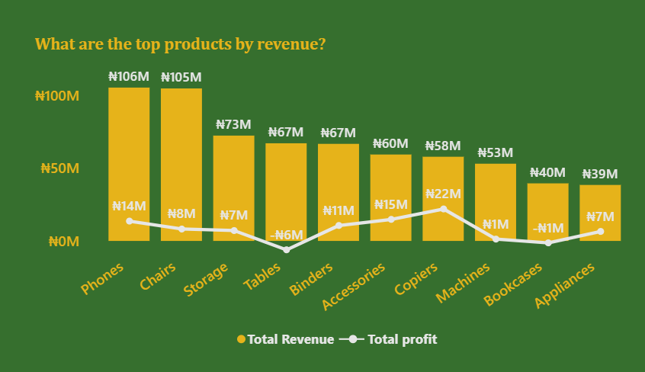
What are the best-selling products?
Of a total of 1862 products which are categorized into Technology, Furniture and Office Supplies, Phones are the best-selling products and generated #106 million of the #759 million generated in revenue.
Phones also generated a total of #14 million but is not the most profitable product.
It was also discovered that the company was running at a loss of #6million with the sales of Tables and and #1million with Bookcases.

Slide 7
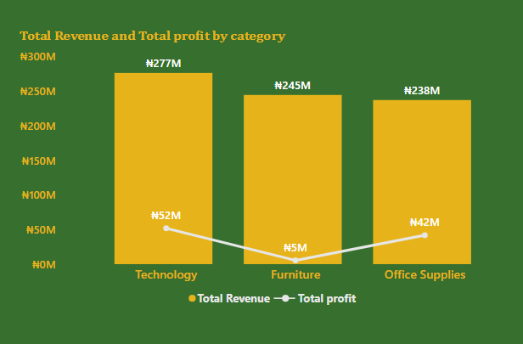
In what category are we not profitable?
Category furniture generated just about 2% of its revenue .
Technology and Office supplies generated approximately 19% and 18% respectively of their revenue.

Slide 8
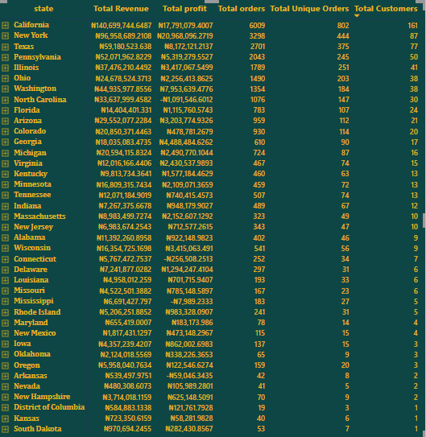
What state has the highest number of Customers and generated the highest revenue?
There are 785 customers across 39 states in 4 regions. The Purchase frequency of each customer is 39 (number of times a customer makes purchase from 2015 to 2017) while the Average Order Value per customer is #25,000.
California generated the highest revenue of the 39 states which is %18.5 of the total revenue.
23% of the total orders was recorded in California . This is almost twice of the orders recorded in New York which is the second highest revenue generating state although the best in terms of profit .
20.5% of the total customers live in California, followed by New York (11%) and Texas (9.8%).

Slide 9
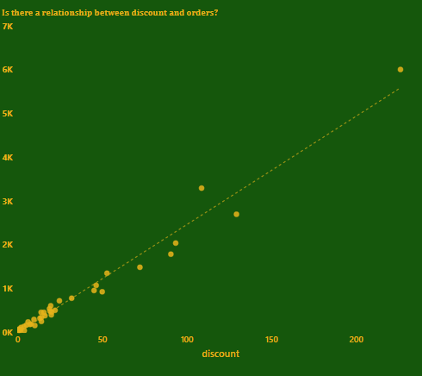
Does Discount have an impact on the number of Orders received?
A positive correlation can be seen from the chart which implies that more orders are received when Vacat stores gives discount on products.

Slide 10
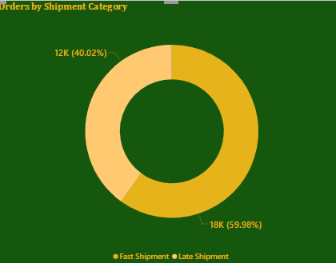
Distribution of Order shipment category ?
Of the 30,000 orders recorded, approximately 60% of the total were shipped before 4 days which is regarded as fast shipment.

Slide 11
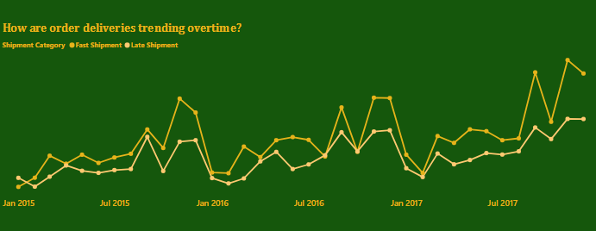
How are deliveries trending overtime?
Between January 2015 and December 2017, fast(1239.24% increase) and late(323.57% increase) shipment have both trended up.
The highest number of deliveries are usually recorded in November of every year, and this can be attributed to the annual US thanksgiving that signifies the Christmas shopping season.

Slide 12
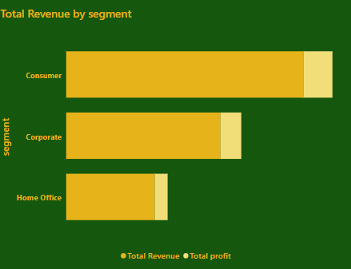
Which segment of our customers generated the highest profit and revenue?
Consumers shop more and in turn generated the highest revenue and profit of the 3 segments(consumer, Corporate and Home Office)
Consumers accounted for 49.4% of the total revenue generated in .

Slide 13
Recommendation
Increase the prices of furniture to generate more profit.
Since consumers generate the highest revenue, more consumer-friendly products should be introduced into the stores across the states.
November is the best month to spend more on ads since it is a season where most orders are received and most revenue generated.
The Standard class shipment mode should be improved on as it accounted for 89.9% of the late shipment.

